Slide 1
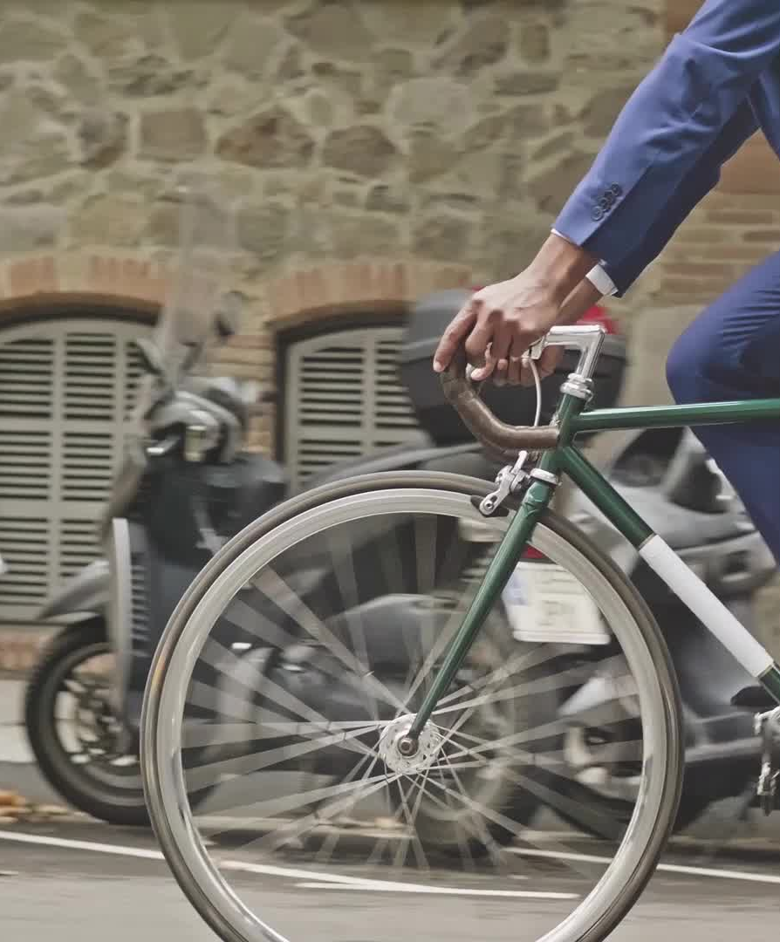
Cyclistic bikes How do annual members and casual riders use Cyclistic bikes differently?
March 2025
Bassam Kasar

Slide 2
Goal for our discussion today
Identify Difference between Member and Casuals in Q1 2019 and 2020
We will discover the difference between members and casuals using analytics of Trips, Days, and Stations
Provide recommendations to increase members
We will discover potentials to increase number of members based on analytics

Slide 3
Cyclict Bike-Share: A Data-Driven Approach to Growth
To get started, I encourage you to revisit the case study document:
"Case Study 1_How does a bike-share navigate speedy success.pdf".
"Divvy_Trips_2019_Q1_V1.CSV".
"Divvy_Trips_2020_Q1_V1.CSV".
It likely contains more details about Cyclict's specific challenges and what they hope to achieve.

Slide 4
Exploring Cyclict Ridership Patterns
1. Number of Trips depend on Day of Week
We will see the number of Trips of both members and casuals with visuals
2. Number of Ends depend on End stations
We will see the number of Ends of both members and casuals with visuals
3. Number of Starts depend on Start stations
We will see the number of Starts of both members and casuals with visuals

Slide 5
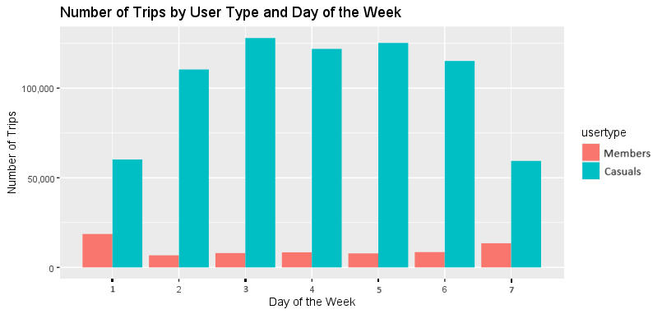
Number of trips depend on Weekdays
Key takeaways
1 is Sunday and 7 Saturday
Highest Trips of Members on Tuesday while Casuals on Sunday
Lowest Trips of Members on Saturday while Casulas on Monday

Slide 6
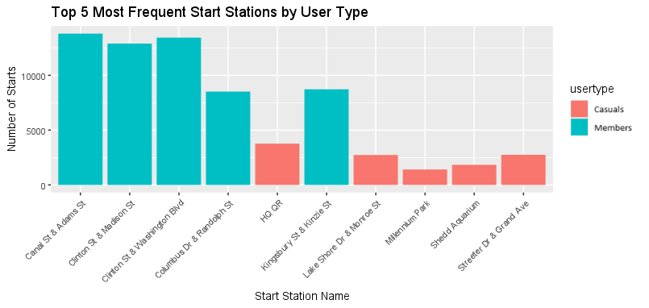
Top 5 Most Frequent Start Stations by User Type
Data Overview
Data show the most used Start stations
Most start station used by Casuals is HR HQ station
Most start station used by Members is Canal St & Adams St

Slide 7
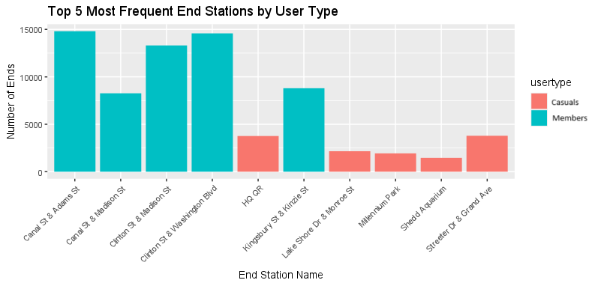
Top 5 Most Frequent End Stations by User Type
Data Overview
Data Show the most used End Stations
Most end station used by Casuals is HR HQ station
Most end station used by Members is Canal St & Adams St
Here show that both highest start and end station are same

Slide 8
What should Cyclistic bikes do After seen
Advertise at start, end stations, and highest Weekdays of customers
Promotion of annual member at start, end stations, and highest Weekdays of customers
Prepare to number of subscribers expected to come
Extend over the Chicago city for avoiding bike traffic

